Slide 1
Vision Becoming Reality
How we got to where we are in our Central Business District
How we can move forward to achieve our community’s long-term vision

Slide 2
The History of the World, Part I
How we got to where we are in our Central Business District

Slide 3
First, the Earth Cooled
But, only after numerous studies as to the feasibility and economic impact to the central business and residential districts of AE were completed, revised and then restructured; delaying any action, of course, until the next study could be completed

Slide 4
AE’s Commercial District was never afforded the design care the residential district received
George Willis founded AE in 1924
Great pains were taken in laying out the lots, street grid, green space / parks and other public areas for the residential side
Tudor Village built in 1926
Great Depression of 1929 disrupted further planning for the commercial ‘side’ of AE and much of our CBD evolved w/o a plan / structure similar to the residential side

Slide 5
AE’s Updated Downtown Master Plan (DMP) now provides an aspirational guide
Many-month process involving large numbers of residents, business owners and other stakeholders
Several-month period 2013-14
Visionary document calling out land uses, promoting walkability and green space / other public realm

Slide 6
Several important events shaped our current opportunity (Part 1)
2004/2014 – DMP development
2013 - AE BOMC resolution to purchase 4 acres in the middle of the Central Business District
2015 – AE becomes a Main Street City
2015 – Second Century Avondale (SCA) is formed by residents to advocate for walkable and design driven CBD featuring adequate green space
2016 - AE Comprehensive Plan
2017 – BOMC Sponsors public process to select best conceptual use of 4 acres

Slide 7
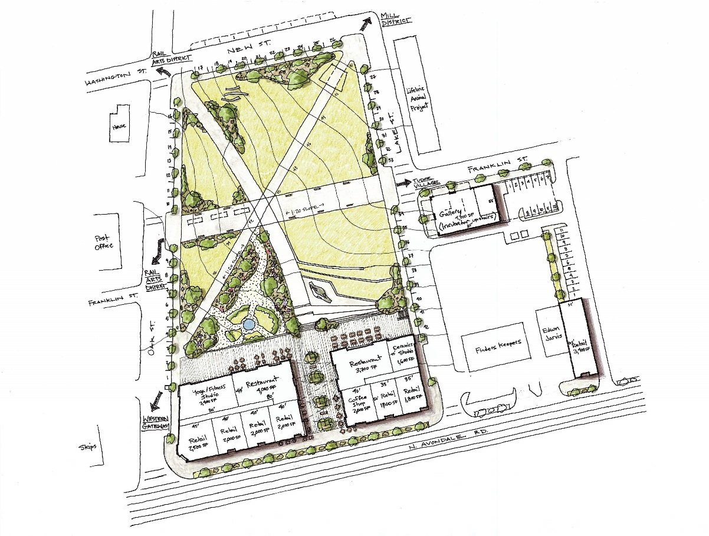
It took some time…
…but we selected Plan Nine!

Slide 8
Several important events shaped our current opportunity (Part I1)
2018 – BOMC, supported by Bleakly economic analysis, provides requirements to RFQ
Terrace and Breezeway
Retail/Commercial use on 1st floor
Other development characteristics
2019 – DDA purchases adjoining 1 acre

Slide 9
How do we turn Vision into Reality? (Part I)
The city publicly issued an RFQ (Request for Qualification) to developers.
With multiple responses, the next step would have been the issuance of an RFP (Request for Proposal).
One response was received - a collaboration between Fabric Developers, Stevens & Wilkinson (including the designer of Plan 9) and Vantage Realty Partners.
Many similar projects were included in Fabric’s qualifications, notably:
Parsons Alley in Duluth
Lake City Village Green
Fairlie Poplar Lofts
Glenwood Park Town Center

Slide 10
Thoughtful implementation of the selected design is critical to AE’s livability and to its economic model
Residents stated during the DMP process an overwhelming desire for ‘shops and restaurants’ within walking distance
AE’s recent historical tax base has been over weighted to the residential side – more commercial tax is needed
The Town Green provides a needed gathering spot AND ‘beachfront’ property to attract new businesses

Slide 11
Strategic Investment to Catalyze Development
How we can move forward to achieve our community’s long-term vision

Slide 12
The Town Green is the Centerpiece of Our Downtown Master Plan for Development
Its central location near existing restaurants and shops makes it an ideal gathering space for residents and visitors.
A gathering space “activates” the area, creating a built-in clientele for potential shop and restaurant owners.
This makes a wider range of concepts – such as those preferred by residents – commercially viable.
All these reasons make the City’s commitment to the project a vital part of catalyzing development.
So…Can we afford to make it a reality?

Slide 13
Our Financial Advisor says, “Yes!”
11/18: City contracts with Davenport Public Finance to analyze capital needs and funding options
2/19: Davenport presents “Bonds 101”
3/19: Davenport presents Capital Planning Analysis
4/19: Davenport recommends the issuance of a Bond Anticipation Note (BAN)
5/19: Davenport and Murray, Barnes, Finister recommend creation of Urban Redevelopment Agency (URA)
6/19: City develops an Urban Redevelopment Plan and creates the URA
7/19: City contracts with Murray, Barnes, Finister to assist with preparation of BAN documents; Davenport releases BAN Request for Proposals
8/19: Davenport presents responses; BOMC and URA select top BAN proposal

Slide 14
Debt Capacity: Total Debt ≤1.75% of Full Value Moody’s Aa Threshold
Note: 2018 and 2019 are actual Tax Digest figures; 2020 assumes a 2% increase.

Slide 15
Debt Capacity: Debt Service ≤15% of Expenditures Standard and Poor’s Aa Threshold
Note: 2018 expenditures are actual; 2019 and 2020 assume annual 2% increase.

Slide 16
Total Debt Serviced by $673,669* annually three amortization scenarios
*From previous slide, 15% of audited 2018 expenditures

Slide 17
Six Debt Capacity Calculations as described on previous slides

Slide 18
Available Cash for capital Projects Governmental Funds, not including paving projects
 | 2015 | 2016 | 2017 | 2018 | Average
Revenues and Net Transfers | 3,517,126 | 3,842,677 | 4,352,496 | 4,544,592 | 4,064,223
Expenditures | 3,555,770 | 3,891,996 | 4,333,134 | 3,744,889 | 3,881,447
Fund Balance Increase (Decrease) | (38,644) | (49,319) | 19,362 | 799,703 | 182,776
Plus Cash Capital Expenditures | 595,189 | 283,280 | 29,810 | 271,927 | 295,052
Plus Debt Service | 172,200 | 172,200 | 172,200 | 172,147 | 172,187
Plus DDA Appropriation | - | 36,000 | 180,000 | 78,030 | 73,508
Available for Capital Projects | 728,745 | 442,161 | 401,372 | 1,321,807 | 723,521

Slide 19
Debt Service Affordability Unfavorable Rate Environment, Maximum Borrow
Loan amount | $8,395,000 | Annual interest rate | 5.00%
Annual debt service | $673,637 | Loan period in years | 20
Available cash, governmental funds | $723,521
Available cash, Stormwater Fund | $113,765
Coverage ratio* | 1.243
* A ratio of 1.25 cash/debt service is commonly used as a benchmark for adequate coverage.

Slide 20
Debt Service Affordability Unfavorable Rate Environment, Maximum Borrow
Loan amount | $8,395,000 | Annual interest rate | 5.00%
Annual debt service | $546,107 | Loan period in years | 30
Available cash, governmental funds | $723,521
Available cash, Stormwater Fund | $113,765
Coverage ratio | 1.533

Slide 21
Debt Service Affordability Expected New Revenue from the Western CBD

Slide 22
Interest Rate Scenarios Town Green Project Only
Unfavorable environment
Favorable environment
Annual interest rate | 5.00%
Loan period in years | 30
Annual payment | $380,551
Loan amount | $5,850,000
Total interest | $5,566,527
Total financed cost | $11,416,527
Annual interest rate | 3.50%
Loan period in years | 25
Annual payment | $354,943
Loan amount | $5,850,000
Total interest | $3,023,578
Total financed cost | $8,873,578

Slide 23
Save versus Borrow comparison Favorable and Unfavorable interest rates, 4.56% Construction inflation*
In the “Unfavorable environment” scenario, debt service payments would be about $380,000 annually;
but inflation at historical rates would increase the price tag to over $22 million by 2051,
so the City would have to save about $750,000 each year in order to pay cash by that year.
Unfavorable loan environment
Favorable loan environment
Loan amount in 2023 | $5,850,000
Annual interest rate | 5.00%
Loan period in years | 30
Total interest | $5,566,527
Financed total cost | $11,416,527
Cash total cost in 2053 assuming 4.56% inflation | $22,290,669
Loan amount in 2023 | $5,850,000
Annual interest rate | 3.50%
Loan period in years | 25
Total interest | $3,023,578
Financed total cost | $8,873,578
Cash total cost in 2048 assuming 4.56% inflation | $17,835,908
* Source: U.S. Census Bureau, 30-year average new construction inflation through April 2019 census.gov/construction/cpi/

Slide 24
Hypothetical B.A.N. Timeline: Oct 2019 – Dec 2022 Total Debt and Interest Expense at Three Different Rates

Slide 25
How do we turn Vision into Reality? (Part II)
As financing mechanisms and a design process map are put into place, the Bleakly Group leads discussions with the City, the DDA, and the Fabric Team regarding the path forward.

Slide 26
We have a window of time….
We have a team of quality, proven developers at the table
Interest rates are at historic and unexpected lows
The economic cycle WILL end – while exact timing is impossible to predict, there is general consensus among many economists that we are in the ‘late stages’ of current growth
Appropriate process can be accelerated while maintaining public participation

Slide 27
….And many things to do! Turning Concept 9 vision into reality
Finalize financing approach
Communicate and execute public input process regarding park design
Communicate and execute public input process regarding commercial design
Finalize development approach with assistance from Bleakly
City’s focus - public realm development (Town Green design and development)
DDA’s focus – commercial development
City / DDA Intergovernmental agreements
Parking lot and 90 N Avondale improvements
Approach/agreement regarding commercial agreement
Developer discussions/presentations/negotiations
Development Agreement

Slide 28
So – pencil in these dates!
BOMC Meetings (Regular and Special Called)
8/12, 8/26,9/9,9/23 (5:30 City Hall)
BOMC Work Sessions (Regular and Special Called)
8/7, 8/20, 9/4, 9/18 (5:30 City Hall)
DDA Meetings
8/13, 9/9, 10/8 (6:30, City Hall)
DDA Special Called Meetings
8/27, 9/24 (6:30, City Hall)

